Slide 1
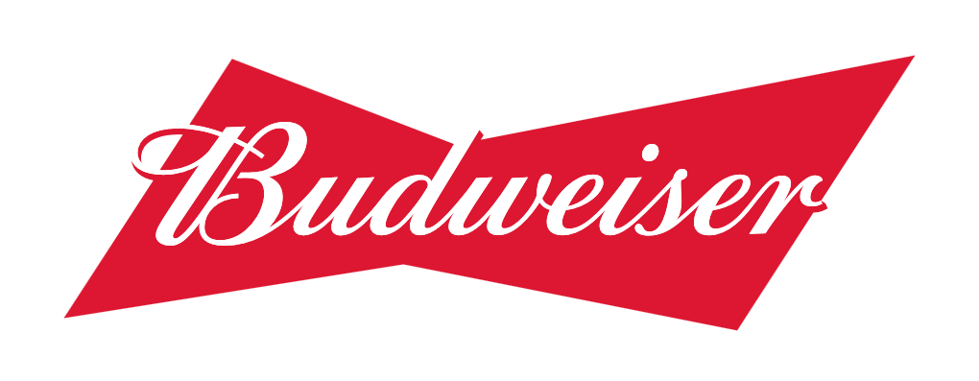
Craft Breweries in the US
A review of Alcohol by Volume and Bitterness across Breweries in the United States
Analysis by Josh Eysenbach and Julia Layne

Slide 2
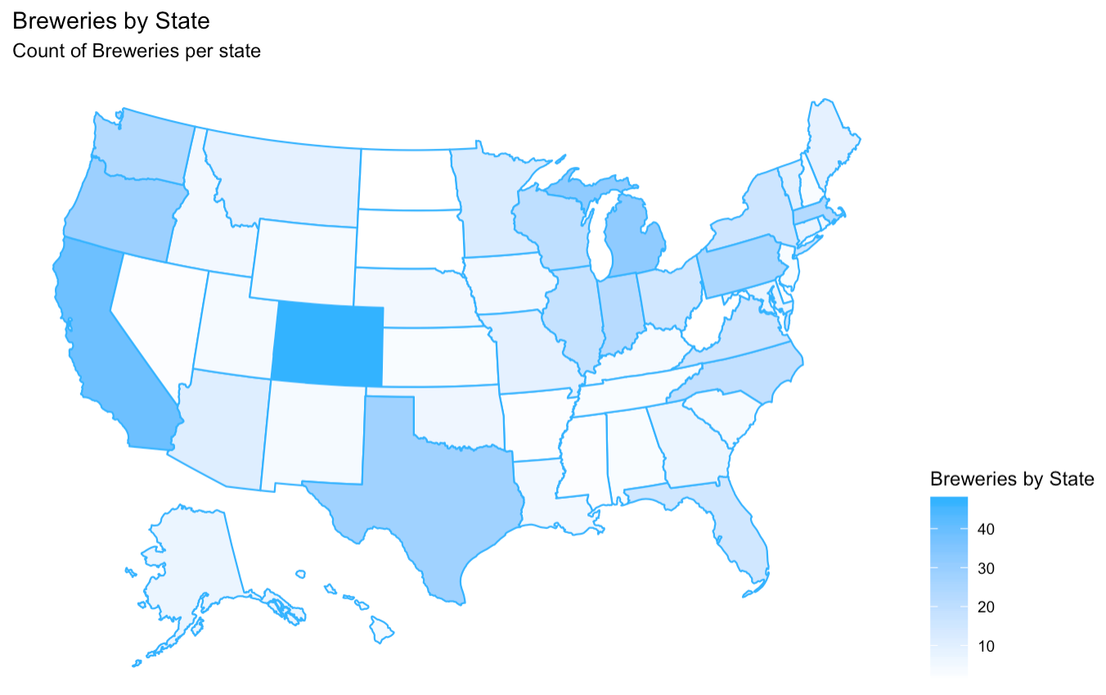

Number of Breweries per State
State | Breweries |  | State | Breweries
CO | 47 |  | MD | 7
CA | 39 |  | OK | 6
MI | 32 |  | IA | 5
OR | 29 |  | ID | 5
TX | 28 |  | LA | 5
PA | 25 |  | NE | 5
MA | 23 |  | RI | 5
WA | 23 |  | HI | 4
IN | 22 |  | KY | 4
WI | 20 |  | NM | 4
NC | 19 |  | SC | 4
IL | 18 |  | UT | 4
NY | 16 |  | WY | 4
VA | 16 |  | AL | 3
FL | 15 |  | KS | 3
OH | 15 |  | NH | 3
MN | 12 |  | NJ | 3
AZ | 11 |  | TN | 3
VT | 10 |  | AR | 2
ME | 9 |  | DE | 2
MO | 9 |  | MS | 2
MT | 9 |  | NV | 2
CT | 8 |  | DC | 1
AK | 7 |  | ND | 1
GA | 7 |  | SD | 1
 |  |  | WV | 1
Top 5: Colorado, California, Michigan, Oregon, and Texas
Notes:
[1] Total Breweries in Each State

Slide 3
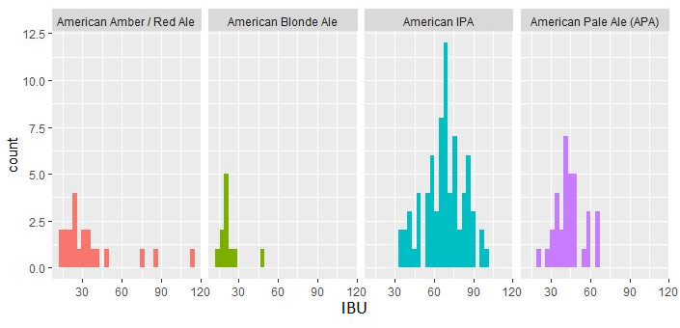
Missing Data
There are 1005 beers with missing values for IBU
We found values vary greatly by beer type and within types
We’ve decided to remove the missing values to avoid distorting results replacing over 40% of the data
Missing Values
ABV: 62
IBU: 1005
IBU Distributions by Beer Style
Notes:
Beers missing ABV or IBU data: There are a few ways we could go about dealing with these but the best way to glean reliable information from any statistics related to this data would be to ignore entries with missing values for the variable(s) being examined, as using any input (like say, a mean) in place of an unknown value is very likely to misrepresent the true nature of the data.
In this case, IBU is a good example of the potential perils of trying to impute missing values because it varies between beers regardless of style (see histograms of a few styles as evidence). The IBU measurement is going to be impacted heavily by the flavor/taste a brewer is going for, and breweries have little practical interest in producing beers that aren’t distinguishably different than those they already have, especially if they will produce multiple iterations of a certain style. The best course of action is probably to exclude beers missing the IBU value when examining IBU despite the misfortune that this excludes over 1000 beers.
For similar reasons, beers missing ABV or style should also be excluded. There is less reason for concern with these exclusions due to the relatively small number of beers missing this information.

Slide 4
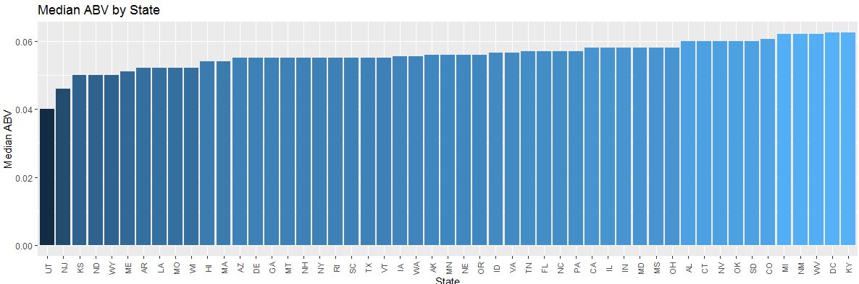
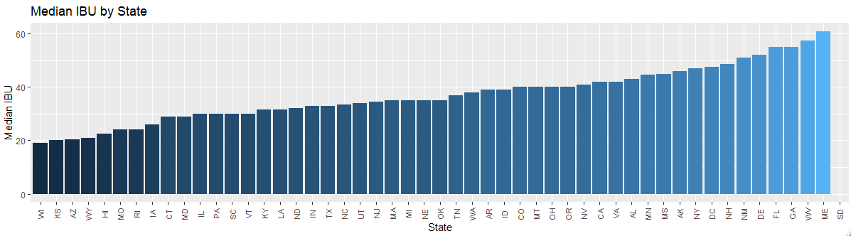
Median ABV and IBU by State

Slide 5
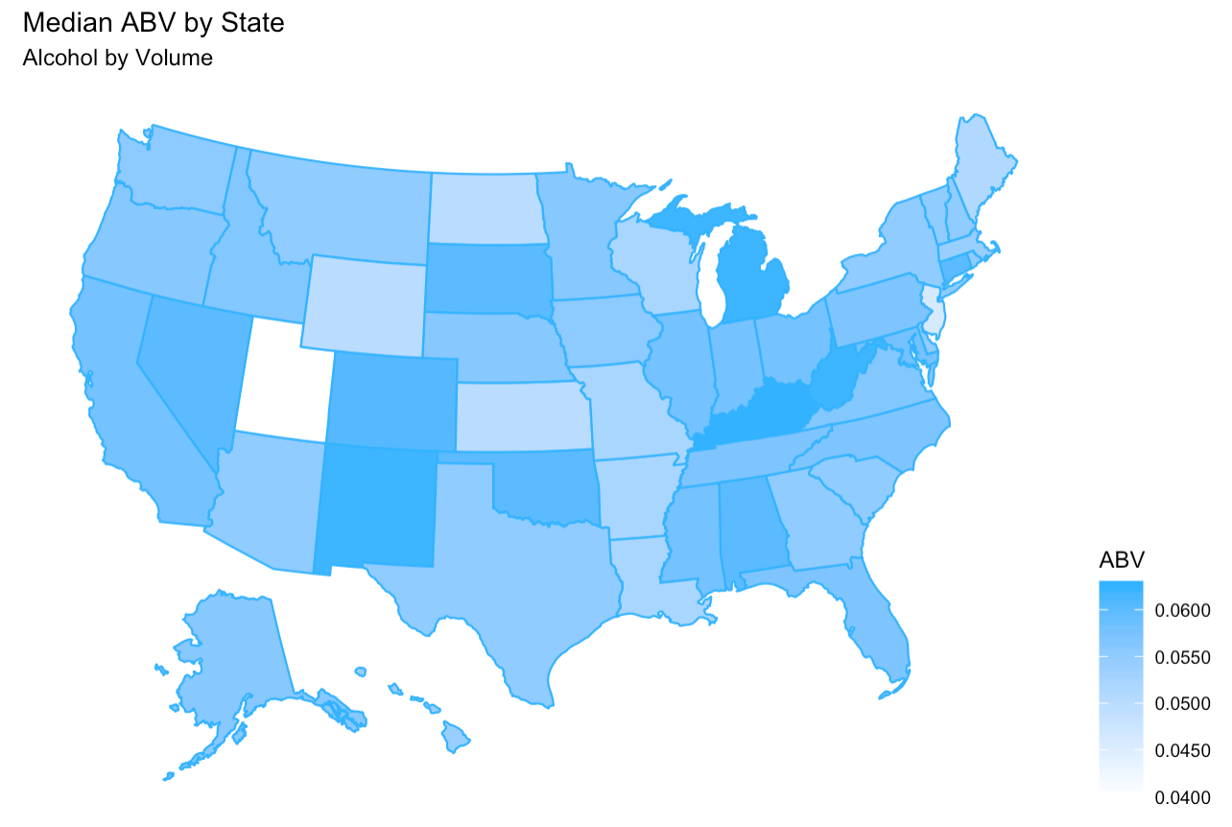
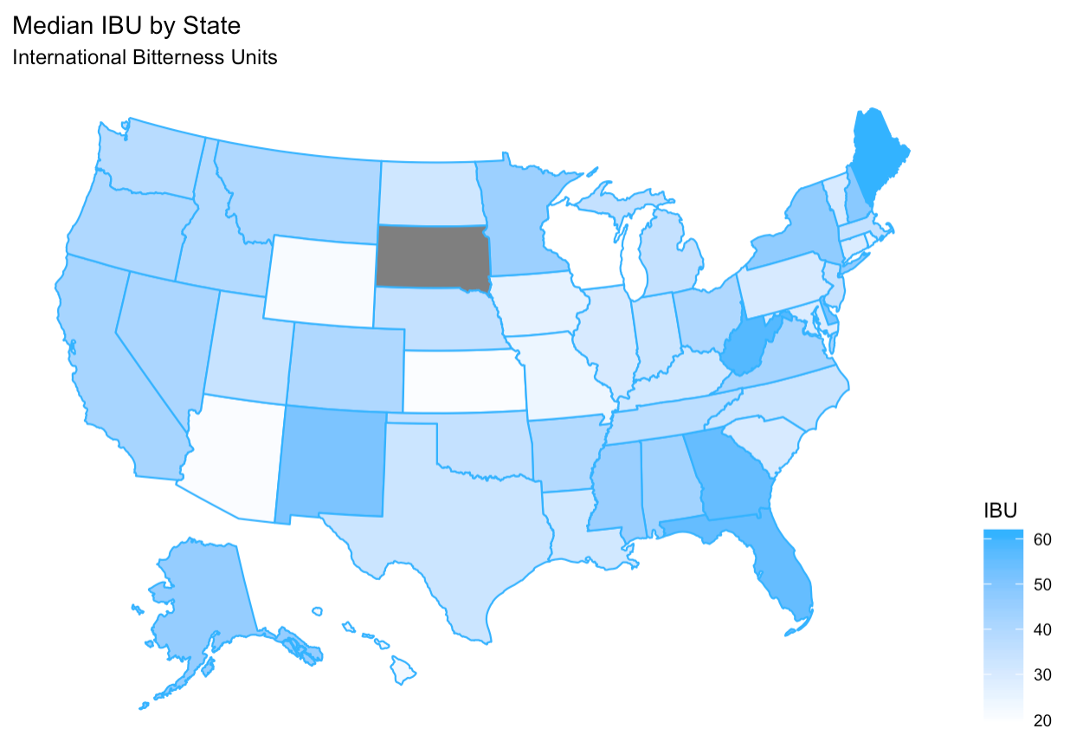
Median ABV and IBU by State
State | Median ABV | Median IBU |  | State | Median ABV | Median IBU |  | State | Median ABV | Median IBU |  | State | Median ABV | Median IBU
AK | 0.056 | 46.0 |  | IL | 0.058 | 30.0 |  | MS | 0.058 | 45.0 |  | PA | 0.057 | 30.0
AL | 0.060 | 43.0 |  | IN | 0.058 | 33.0 |  | MT | 0.055 | 40.0 |  | RI | 0.055 | 24.0
AR | 0.052 | 39.0 |  | KS | 0.050 | 20.0 |  | NC | 0.057 | 33.5 |  | SC | 0.055 | 30.0
AZ | 0.055 | 20.5 |  | KY | 0.063 | 31.5 |  | ND | 0.050 | 32.0 |  | SD | 0.060 | NA
CA | 0.058 | 42.0 |  | LA | 0.052 | 31.5 |  | NE | 0.056 | 35.0 |  | TN | 0.057 | 37.0
CO | 0.061 | 40.0 |  | MA | 0.054 | 35.0 |  | NH | 0.055 | 48.5 |  | TX | 0.055 | 33.0
CT | 0.060 | 29.0 |  | MD | 0.058 | 29.0 |  | NJ | 0.046 | 34.5 |  | UT | 0.040 | 34.0
DC | 0.063 | 47.5 |  | ME | 0.051 | 61.0 |  | NM | 0.062 | 51.0 |  | VA | 0.057 | 42.0
DE | 0.055 | 52.0 |  | MI | 0.062 | 35.0 |  | NV | 0.060 | 41.0 |  | VT | 0.055 | 30.0
FL | 0.057 | 55.0 |  | MN | 0.056 | 44.5 |  | NY | 0.055 | 47.0 |  | WA | 0.056 | 38.0
GA | 0.055 | 55.0 |  | MO | 0.052 | 24.0 |  | OH | 0.058 | 40.0 |  | WI | 0.052 | 19.0
HI | 0.054 | 22.5 |  | MS | 0.058 | 45.0 |  | OK | 0.060 | 35.0 |  | WV | 0.062 | 57.5
ID | 0.057 | 39.0 |  | MO | 0.052 | 24.0 |  | OR | 0.056 | 40.0 |  | WY | 0.050 | 21.0

Slide 6
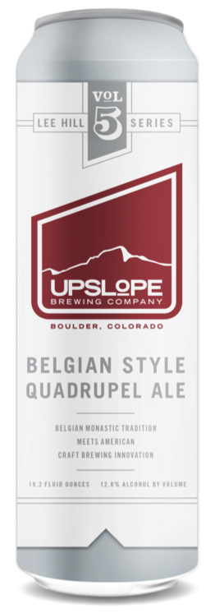
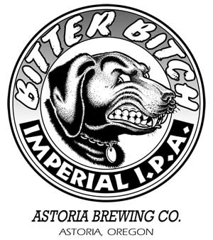
States with Highest ABV and IBU
States with Highest Median ABV:
Kentucky and Washington D.C (6.25%)
State with Highest Median IBU: Maine
(61)
The beer with the highest ABV is located in Colorado
(Lee Hill Series Vol. 5 Belgian Quadrupel Ale -12.8%)
The beer with the highest IBU is located in Oregon
(Bitter Bitch Imperial IPA - 138)
Notes:
Lee hill QA – 12.8% ABV
BB IPA – 138 IBU

Slide 7
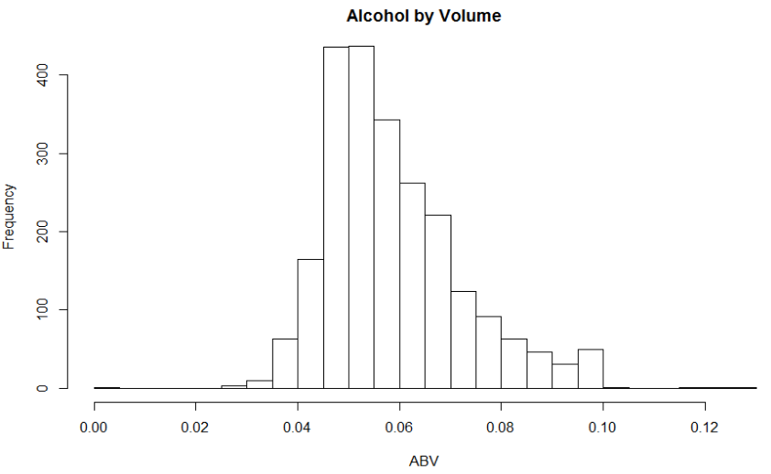
Stats and Distribution of ABV
Mean | Std. dev. | Min | 1st Q | Median | 3rd Q | Max
0.06 | 0.014 | 0.001 | 0.05 | 0.056 | 0.067 | 0.128
Notes:
-distribution of ABV appears fairly normal to slightly right-skewed.
-median ABV is about 5.6% and 75% of the data is contained within the range of 5% to 6.7% ABV, indicating that most beers tend to be close to the median ABV.
-max ABV of 12.8% is a full five standard deviations from the mean of about 6%, and the minimum ABV of 1% is over 4 standard deviations from the mean – rare outliers

Slide 8
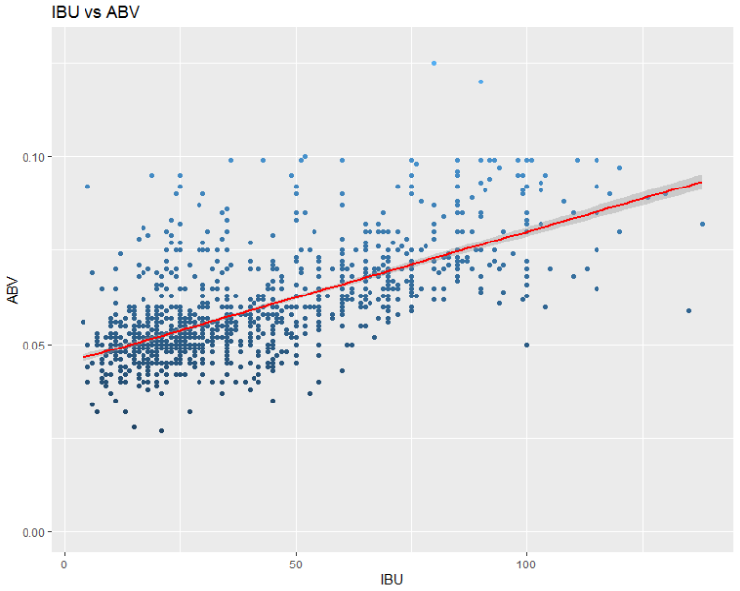
Relationship Between IBU and ABV
r = .67
ABV = .00035*IBU + .0449
Notes:
Based on a scatter plot of ABV vs IBU, there does appear to be evidence of a moderate positive correlation. The ABV looks like it trends upward as IBU increases. The calculated correlation coefficient of .67 supports this.

Slide 9
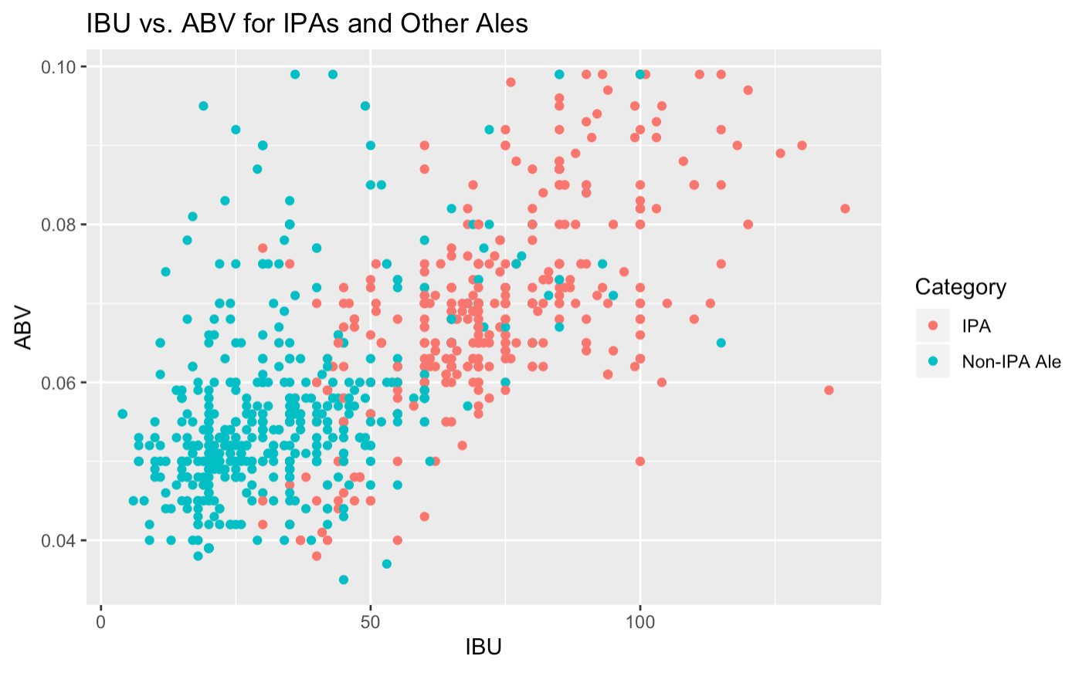
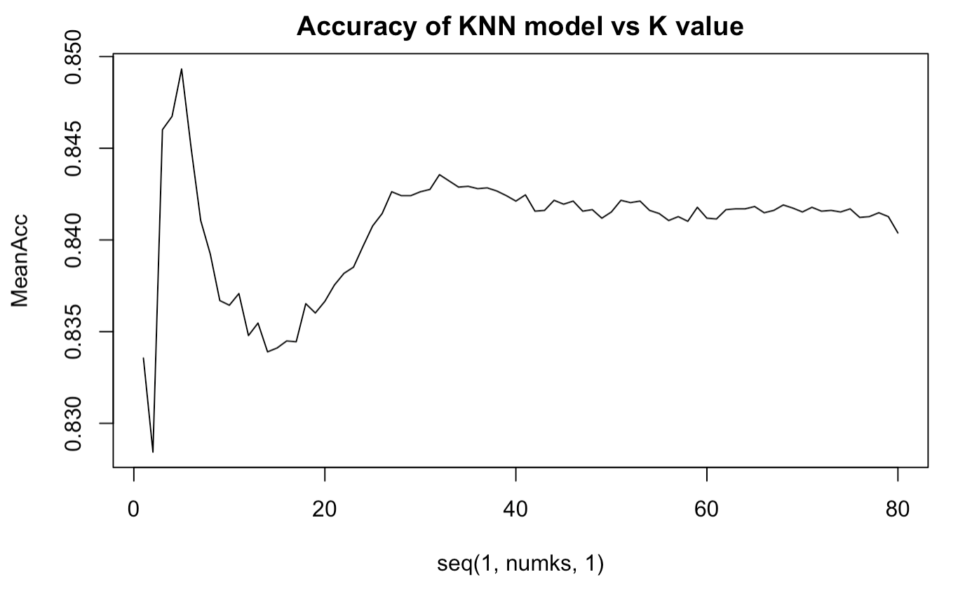
IPAs vs Non-IPA Ales
Seeing the grouping of IPA and Non-IPA charted, a KNN model seemed appropriate for predicting beer style
Comparing the accuracy of different K’s to estimate showed k= 5 had they greatest accuracy at 86.57%
Type to enter a caption.
Type to enter a caption.

Slide 10
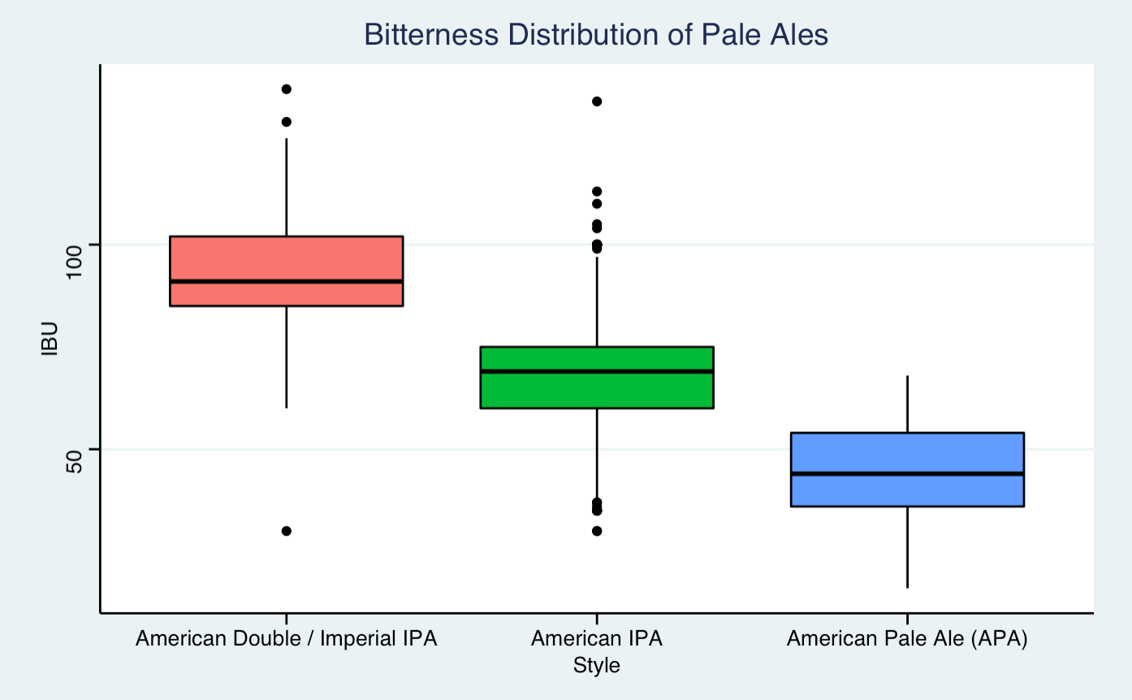
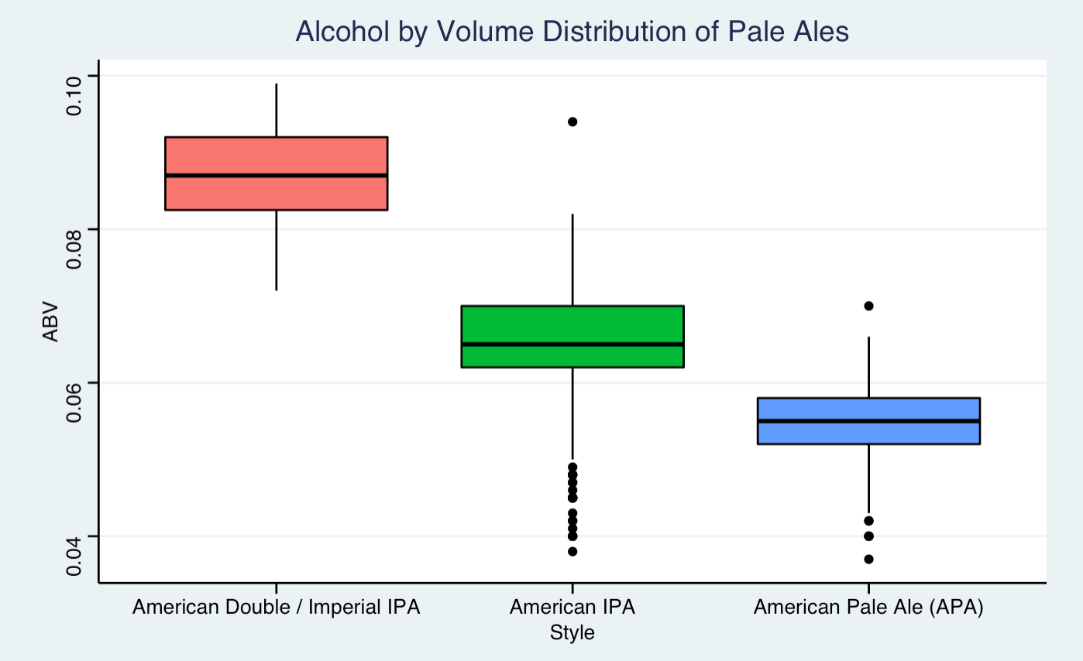
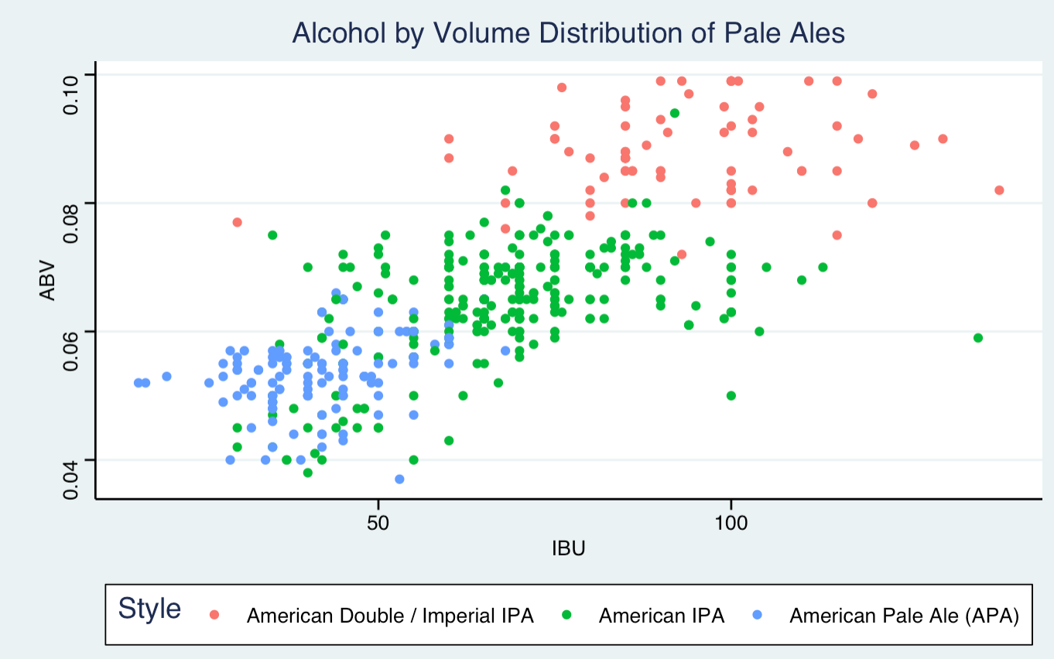
ABV and IBU Distinct in Pale Ale Styles
Visually on we see what appear to be distinct ranges between Pale Ale Styles
Two ANOVAs confirmed that both ABV and IBU are distinct between at least two of the pale ale styles (p < 2e¹⁶)
Following this with Tukey-Kramer tests, we confirmed all groups are distinct in both ABV and IBU (p value so small it evaluated to 0)

Slide 11
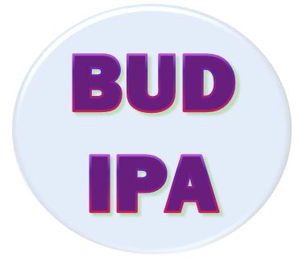
BUDWEISER’S IPA
Based on our comparisons between styles there are distinct ranges for an American IPA on both IBU and ABV. We suggest the IBU and ABV be within the 50% Middle distribution of the American IPA style
Bitterness should be between 60 and 75 IBUs to stay in a distinct IPA range, but not too high to stray from Bud’s signature drinkability
Alcohol content should be a blend between the range or the American IPA and Overall ABVs of 6.2% and 6.7% to make it as widely available as possible while staying true to the IPA style
American IPA IBU (Suggested) | 60 IBU | 75 IBU
American IPA ABV | 6.2% | 7%
Overall American ABV | 5% | 6.7%
Suggested ABV Range | 6.2% | 6.7%
Middle 50% distributions and suggested ranges for IBU ABV

Slide 12
"It is my aim to win the American people over ... to make them all lovers of beer.”
- Adolphus Busch (1905)

Slide 13
Recording available:
https://youtu.be/Xiew0VW_CvI

